Slide 1
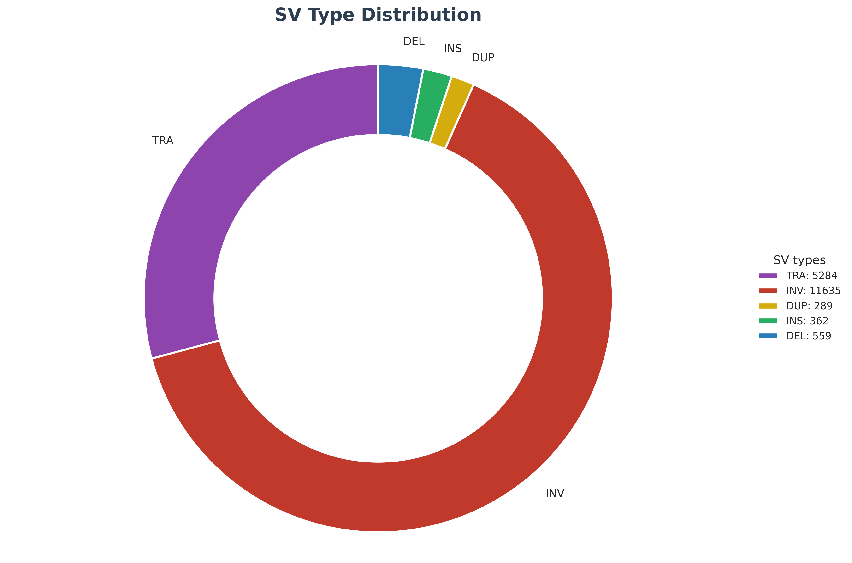
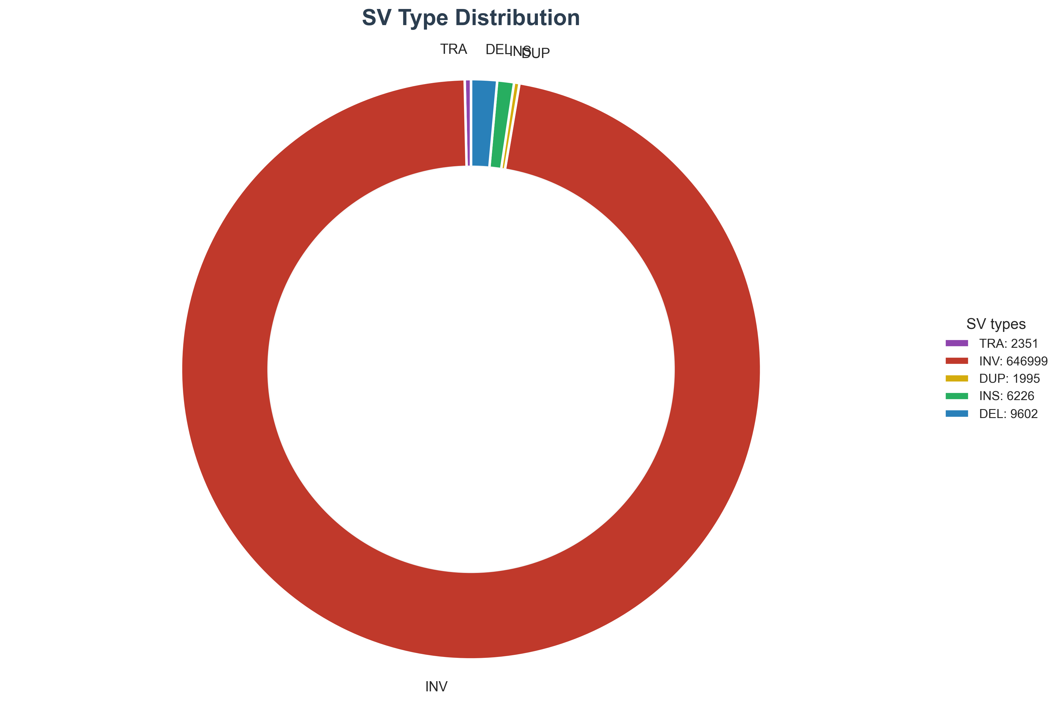
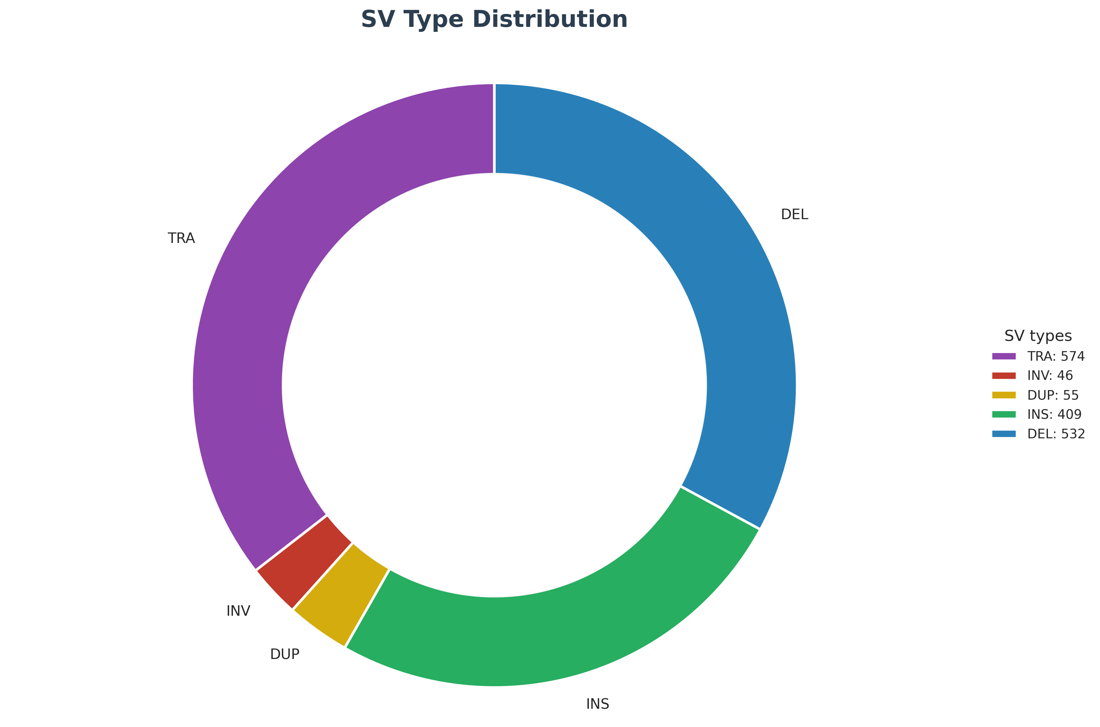
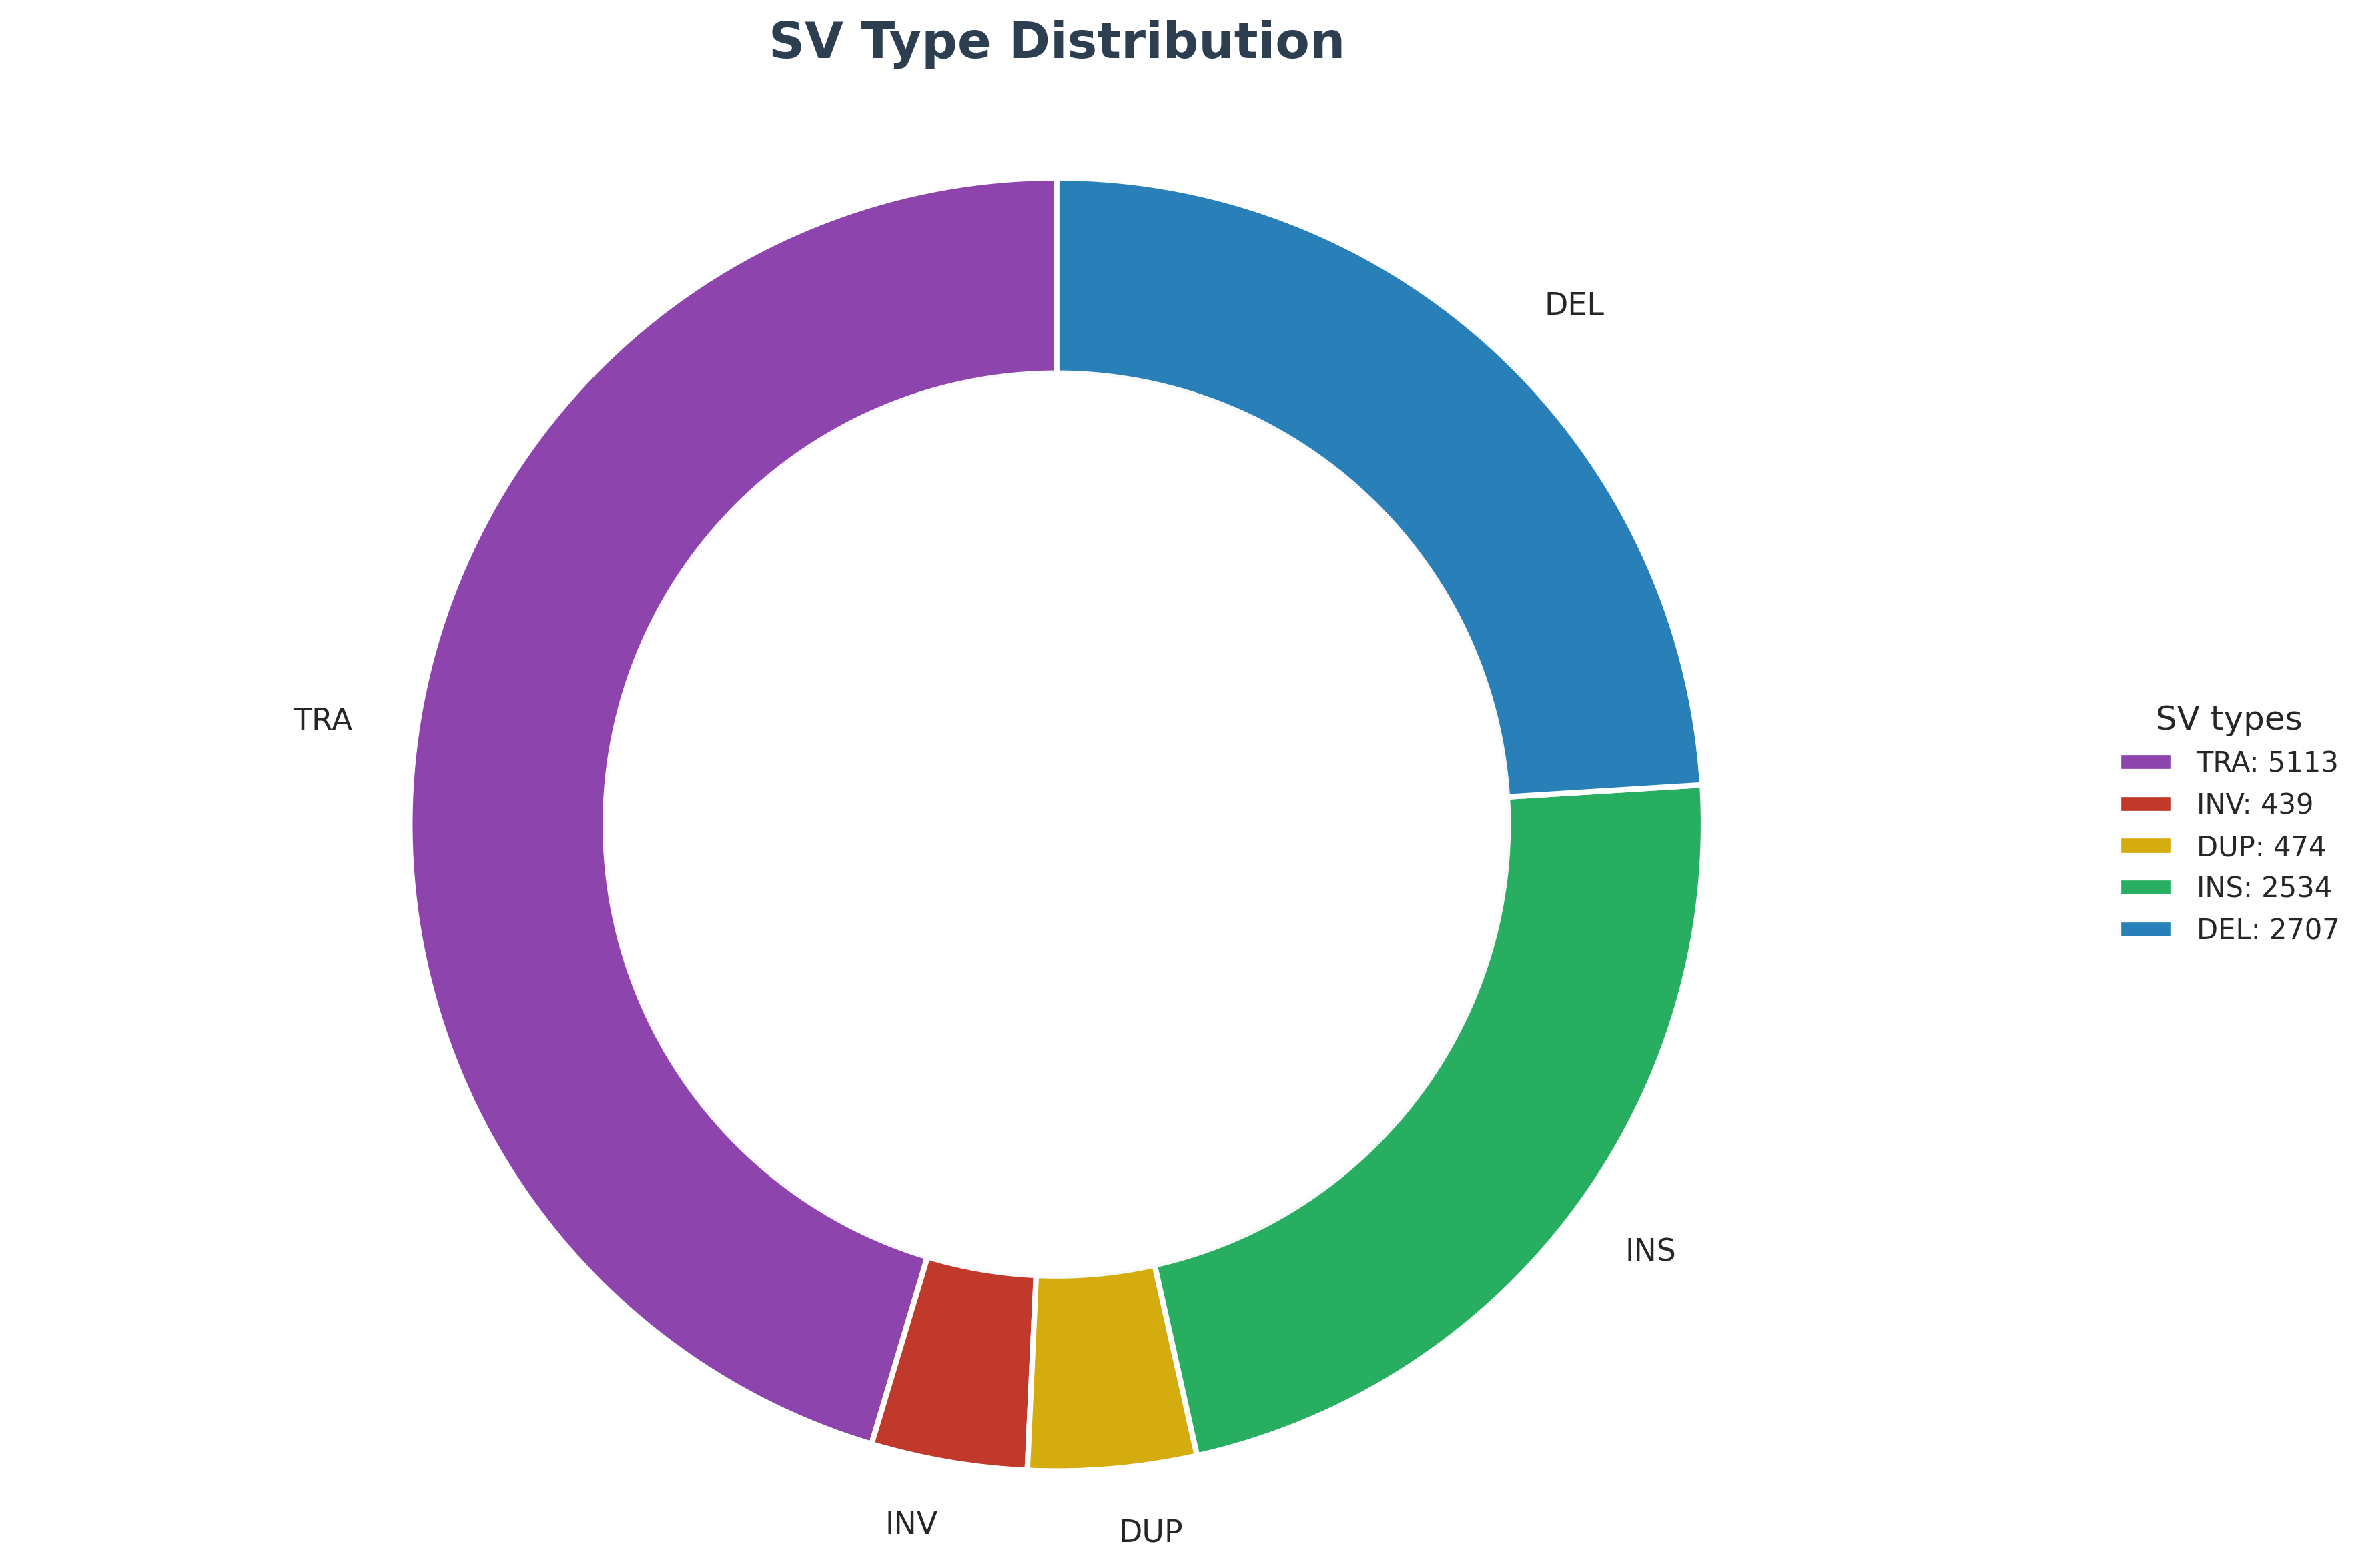
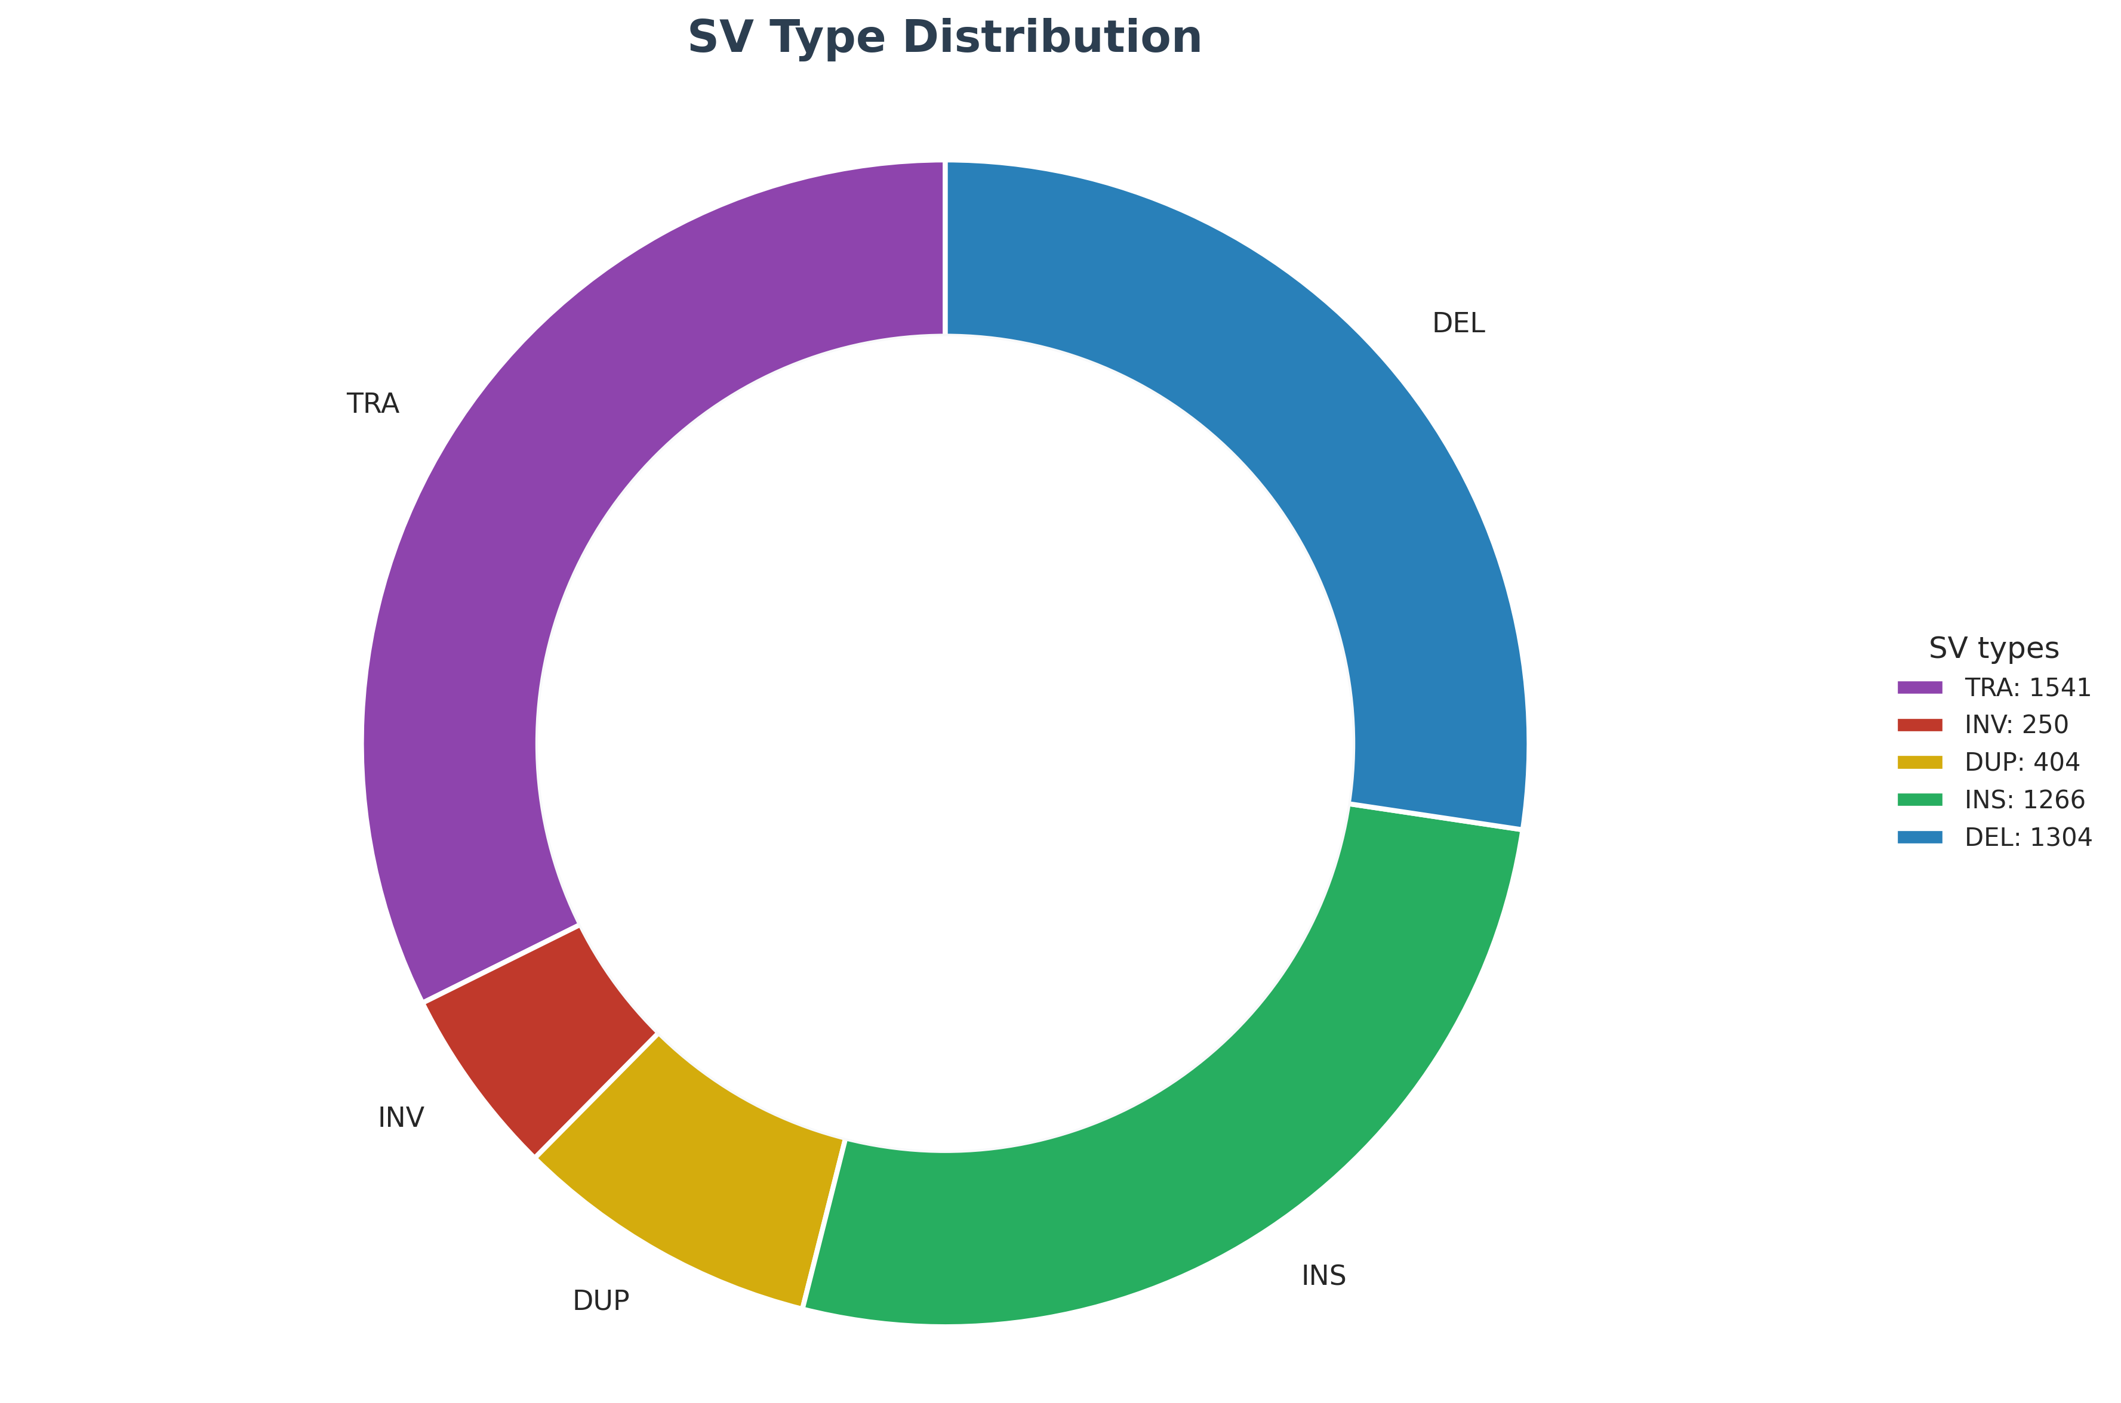
SV type distribution across 5 samples
PC3_10_cells_MDA_Mk1c_dirty
PC3_10_cells_MDA_P2_dirty
PC3_bulk_WGS_P2_clean
PC3_bulk_WGS_Mk1c_clean
PC3_bulk_WGS_Pacbio_clean
Notes:
Make sure the training set is good. Read, more. Yes or no, sequence + breakpoint, only think about the first step, training set, more and accurate.
Input: fastq file, yangyang can convert the fastq file. Breakpoint information.
Fastq read ID: fastq, ID: breakpoint
Positive data set.
Truth dateset. Also fastQ.
Two 60% positive, 40% negative control.
Supporting reads. High confidence. Nanopore.
FastQ format.
Artifacts. Evidence proving it’s true.
Only care about it’s yes or no.
Control noise, accurate very important!!!

Slide 2
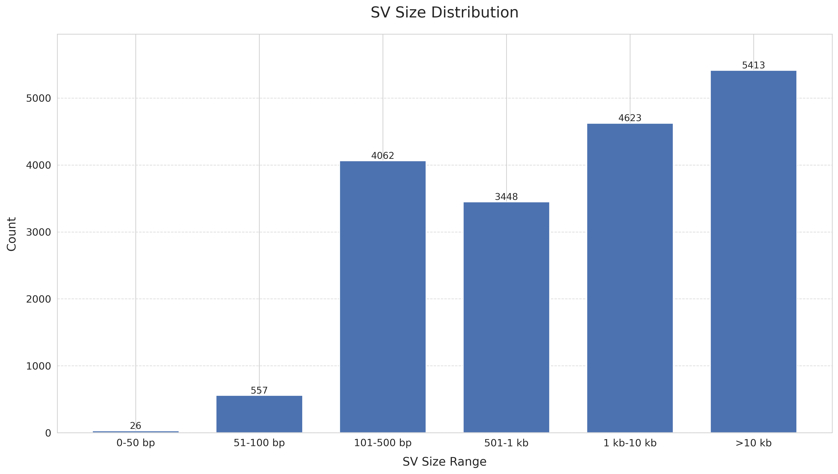
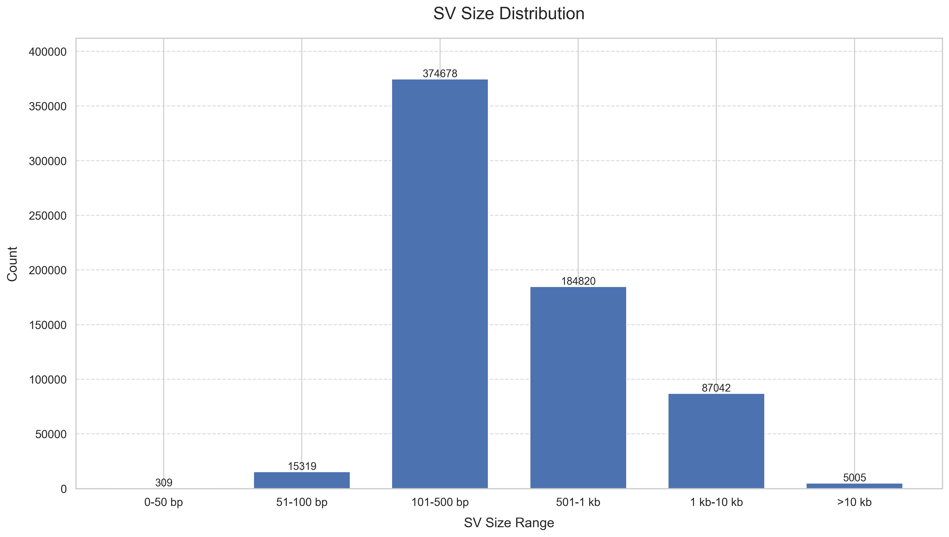
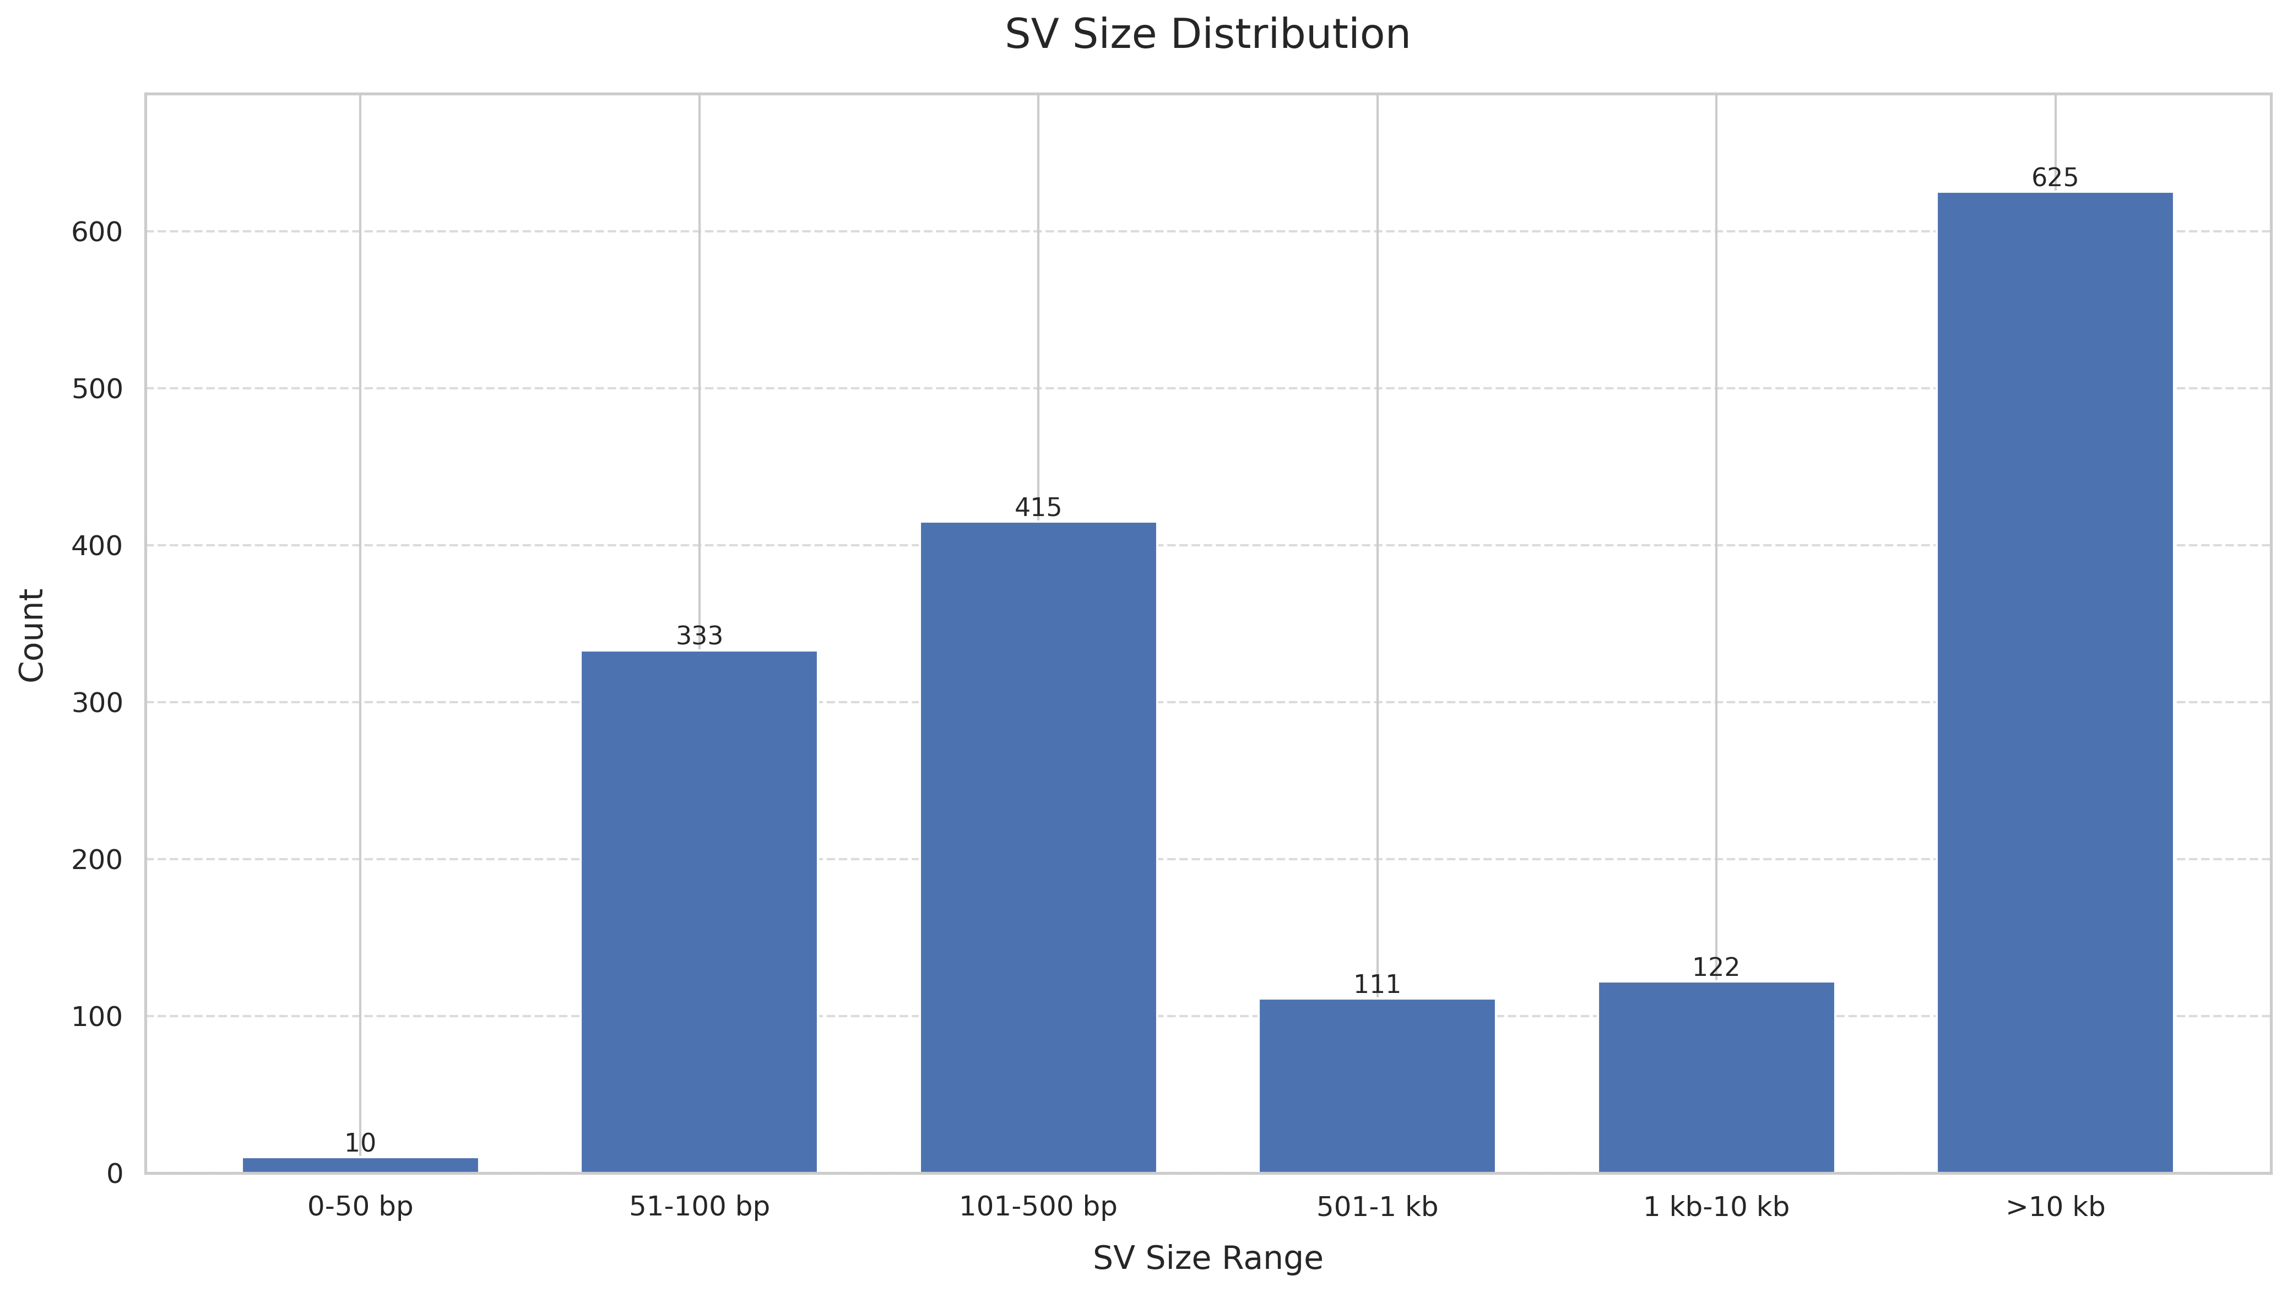
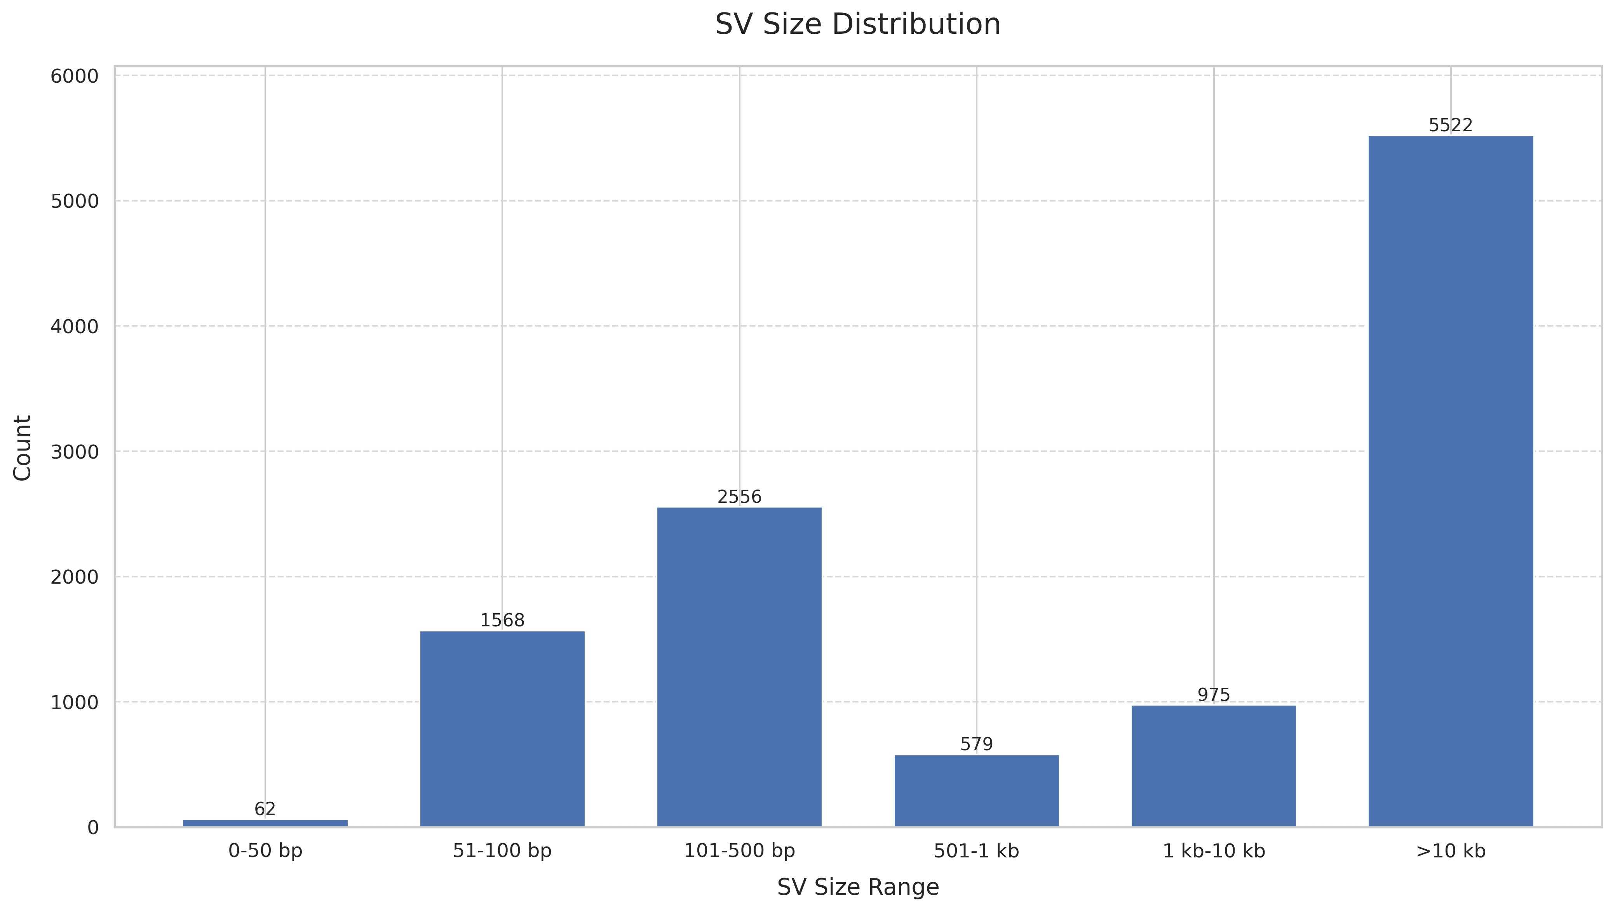
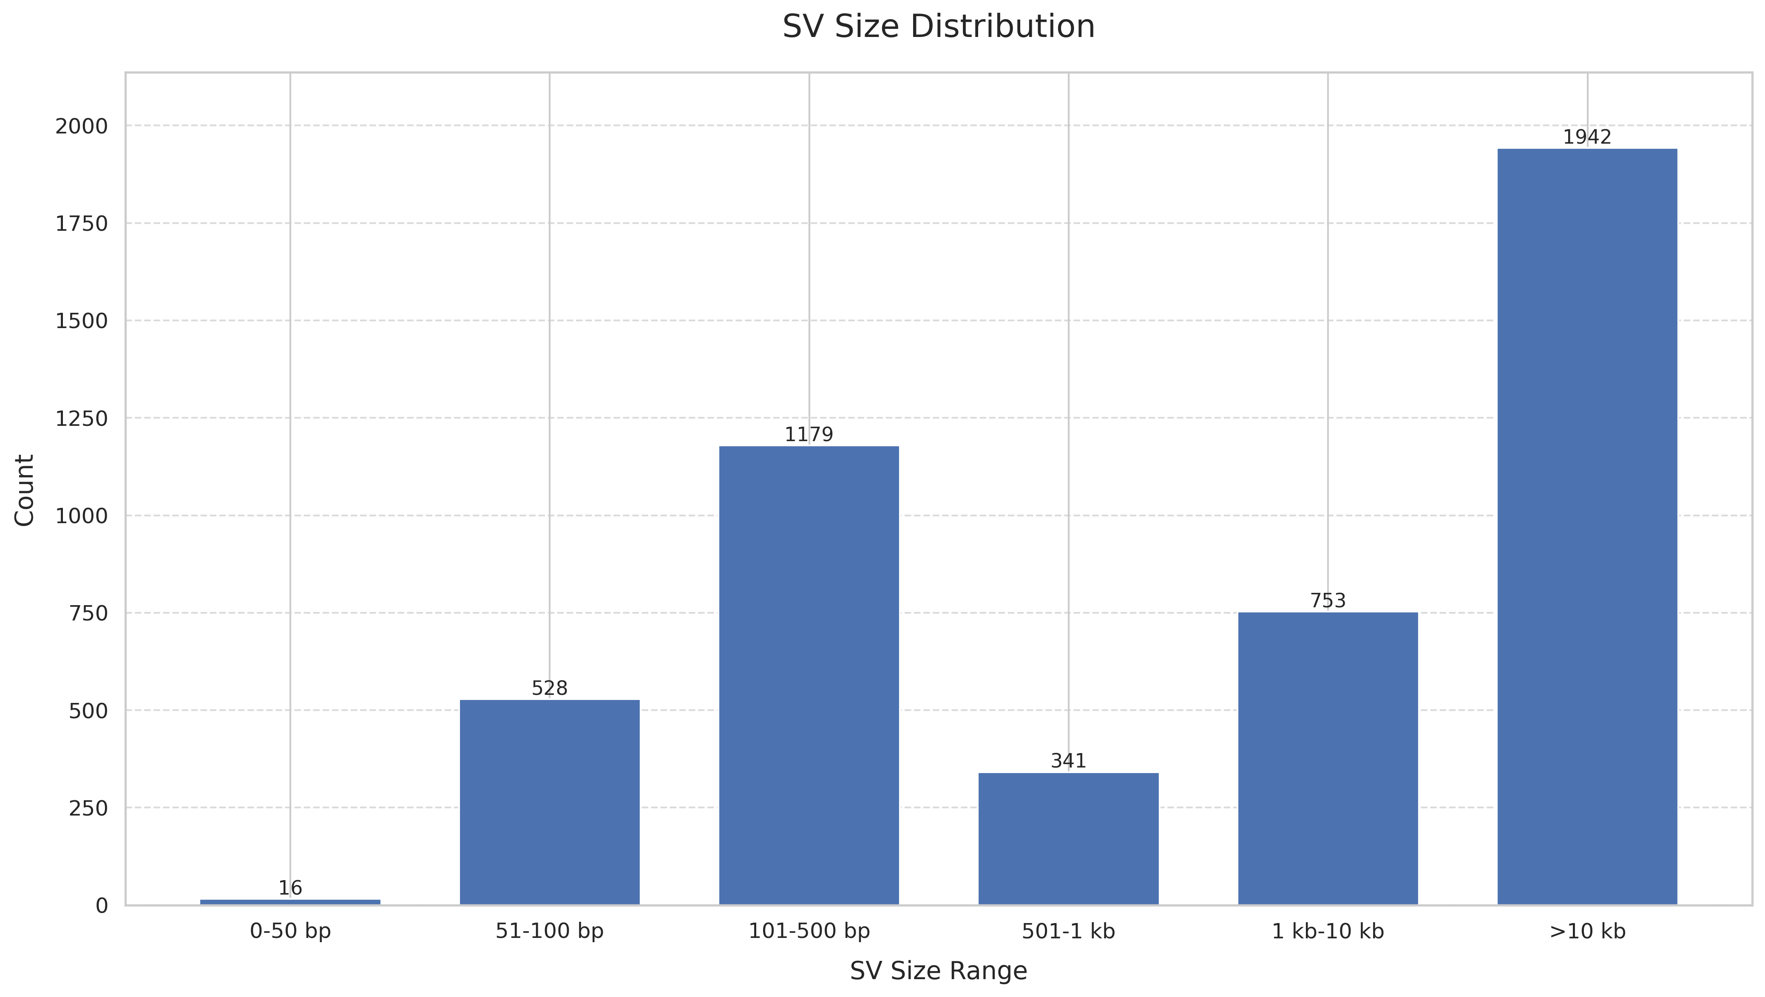
SV size distribution across 5 samples
PC3_10_cells_MDA_Mk1c_dirty
PC3_10_cells_MDA_P2_dirty
PC3_bulk_WGS_P2_clean
PC3_bulk_WGS_Pacbio_clean
PC3_bulk_WGS_Mk1c_clean
Notes:
Make sure the training set is good. Read, more. Yes or no, sequence + breakpoint, only think about the first step, training set, more and accurate.
Input: fastq file, yangyang can convert the fastq file. Breakpoint information.
Fastq read ID: fastq, ID: breakpoint
Positive data set.
Truth dateset. Also fastQ.
Two 60% positive, 40% negative control.
Supporting reads. High confidence. Nanopore.
FastQ format.
Artifacts. Evidence proving it’s true.
Only care about it’s yes or no.
Control noise, accurate very important!!!

Slide 3
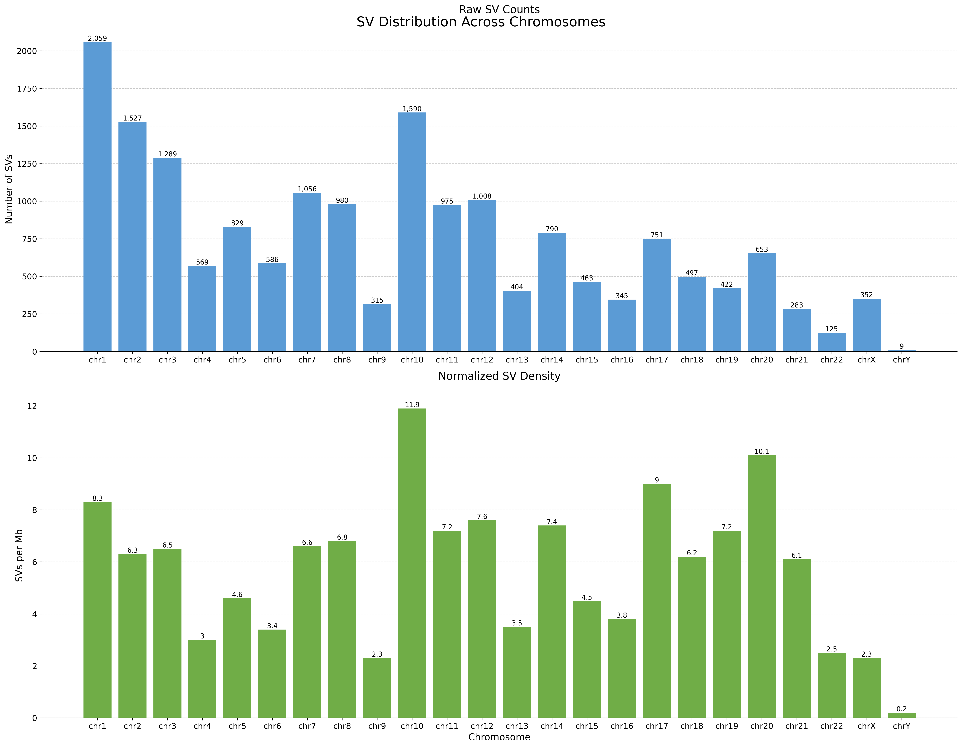
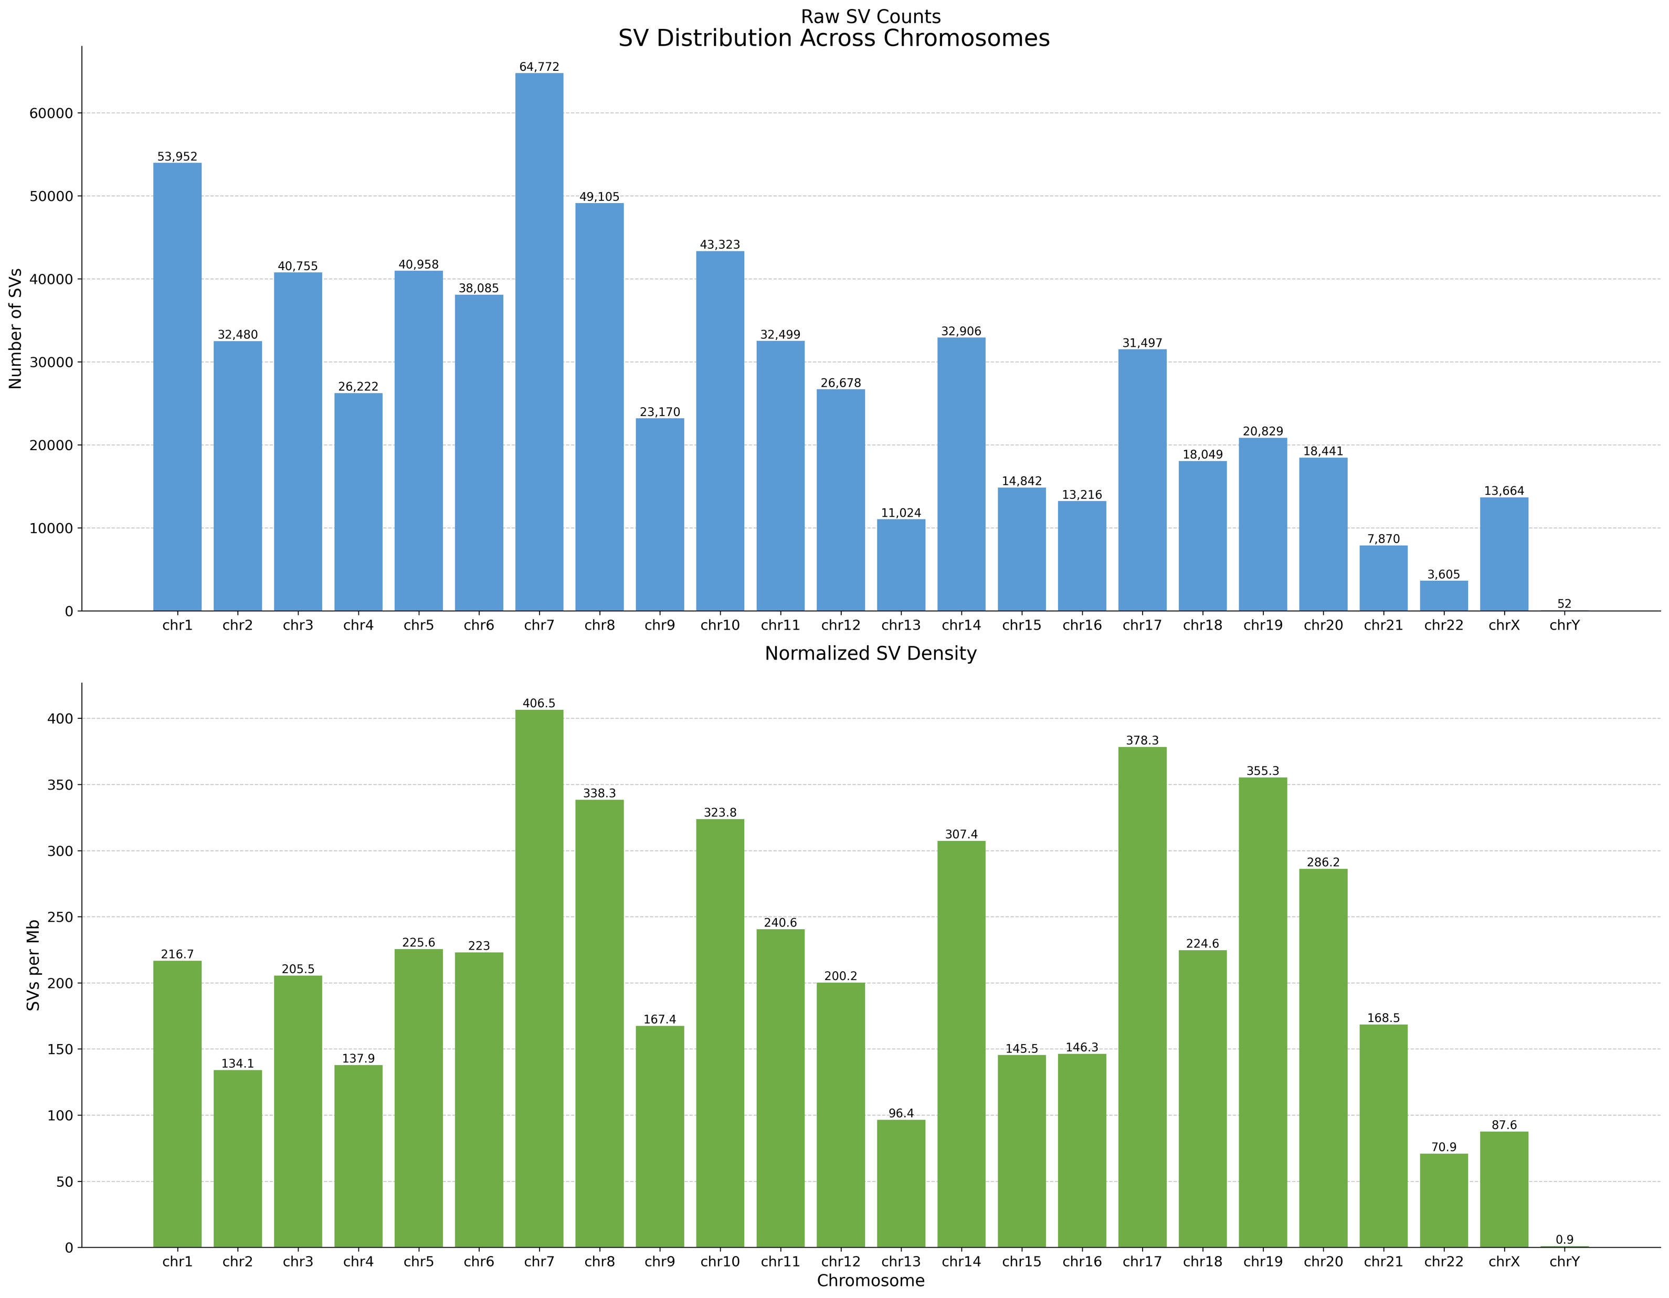
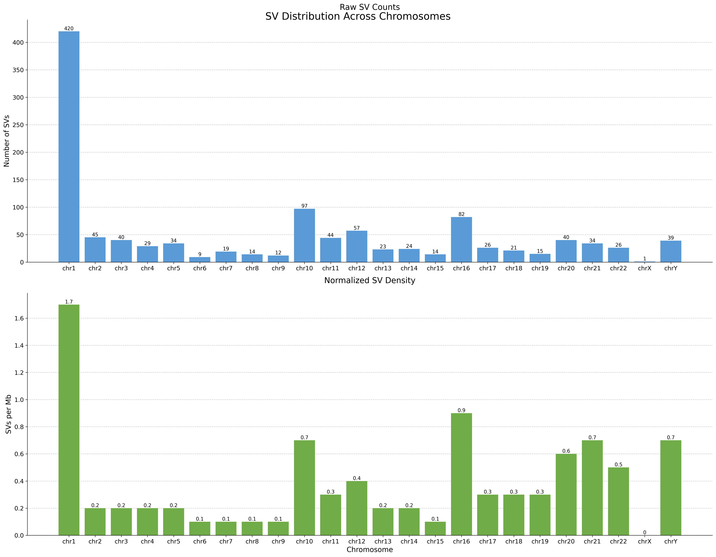
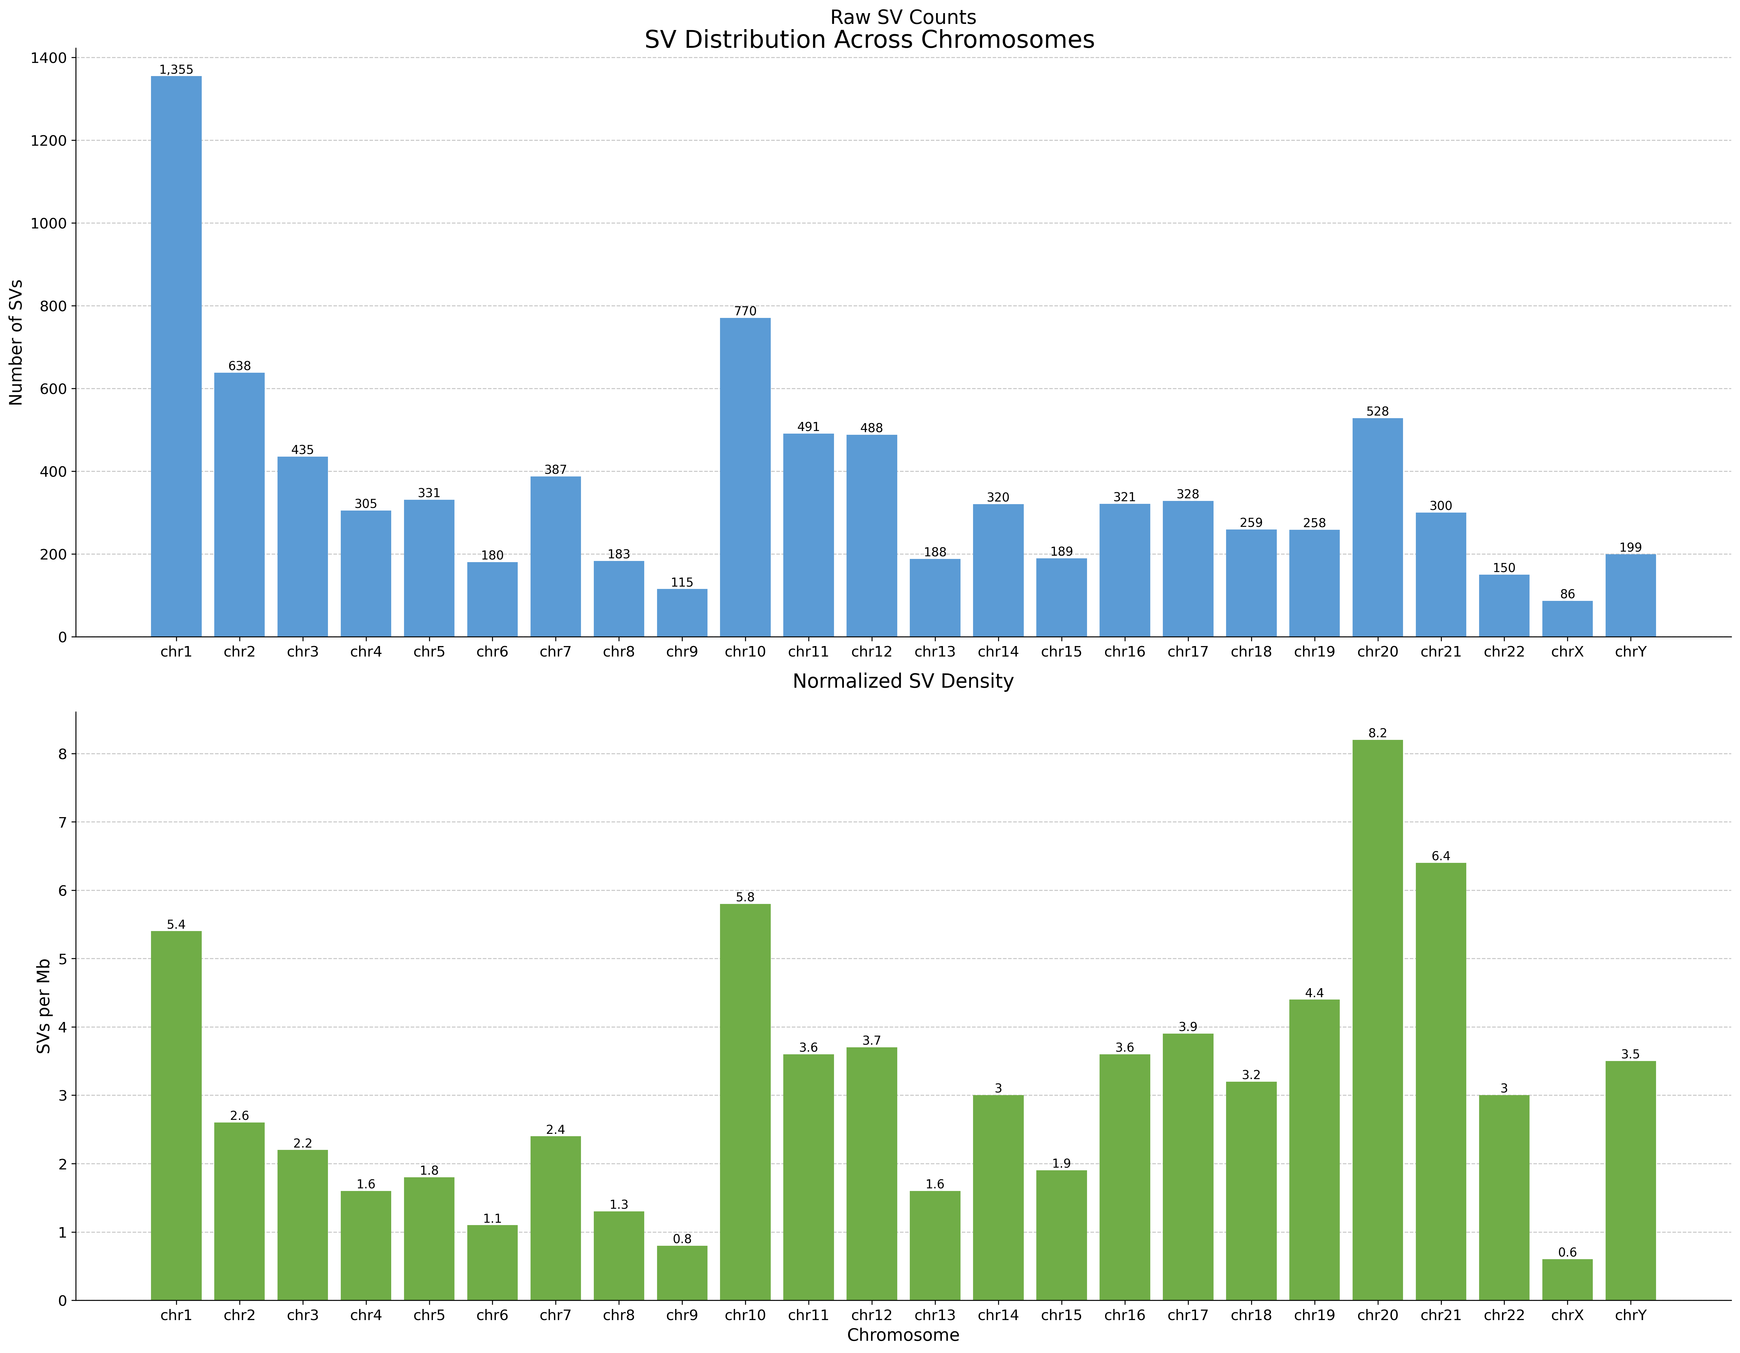
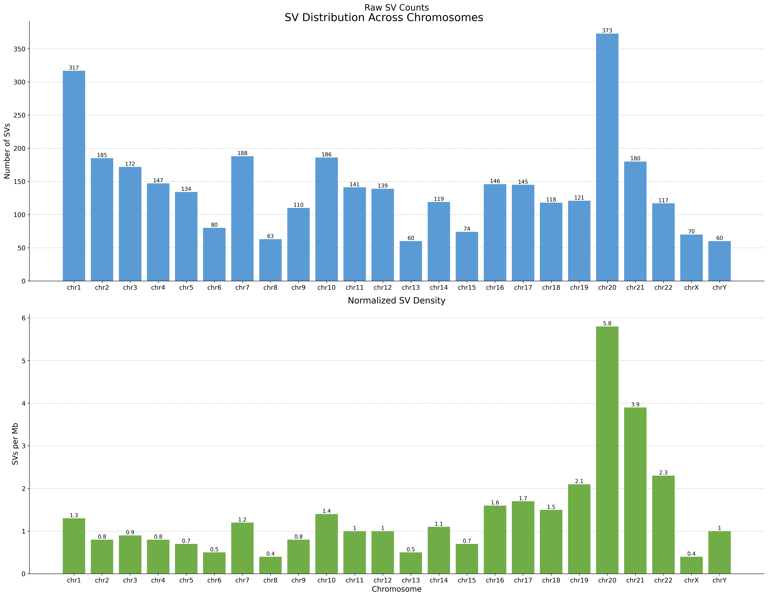
SV chromosome distribution across 5 samples
PC3_10_cells_MDA_Mk1c_dirty
PC3_10_cells_MDA_P2_dirty
PC3_bulk_WGS_Mk1c_clean
PC3_bulk_WGS_P2_clean
PC3_bulk_WGS_Pacbio_clean
Notes:
Make sure the training set is good. Read, more. Yes or no, sequence + breakpoint, only think about the first step, training set, more and accurate.
Input: fastq file, yangyang can convert the fastq file. Breakpoint information.
Fastq read ID: fastq, ID: breakpoint
Positive data set.
Truth dateset. Also fastQ.
Two 60% positive, 40% negative control.
Supporting reads. High confidence. Nanopore.
FastQ format.
Artifacts. Evidence proving it’s true.
Only care about it’s yes or no.
Control noise, accurate very important!!!

Slide 4
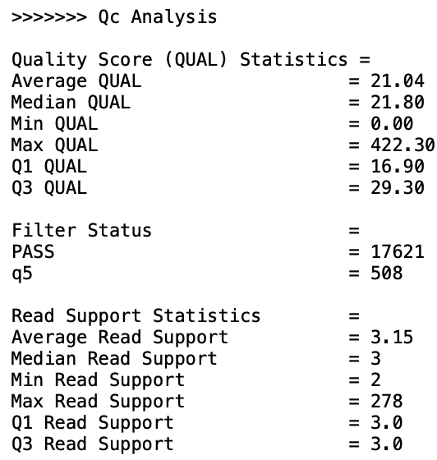
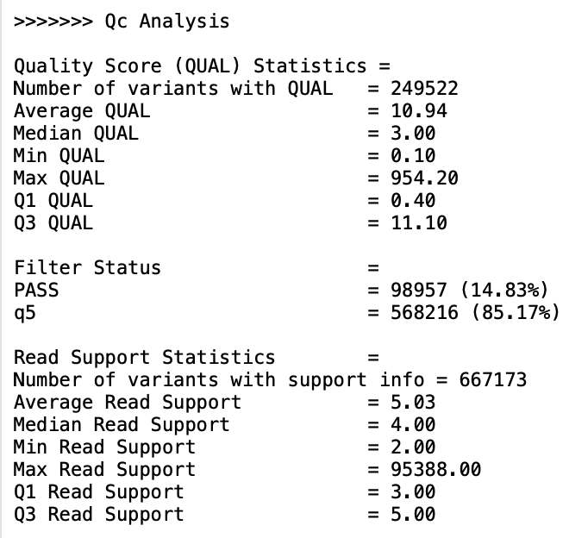
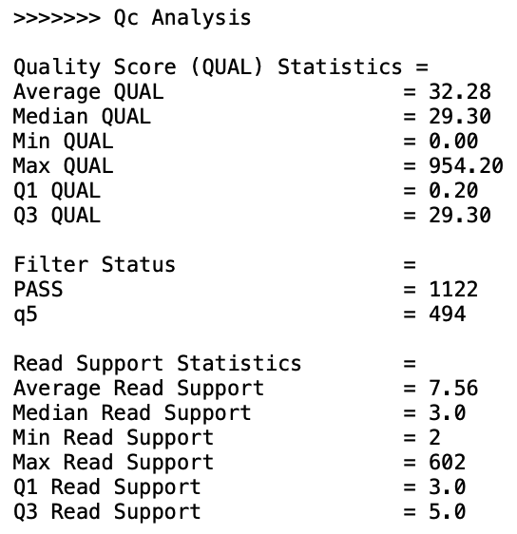
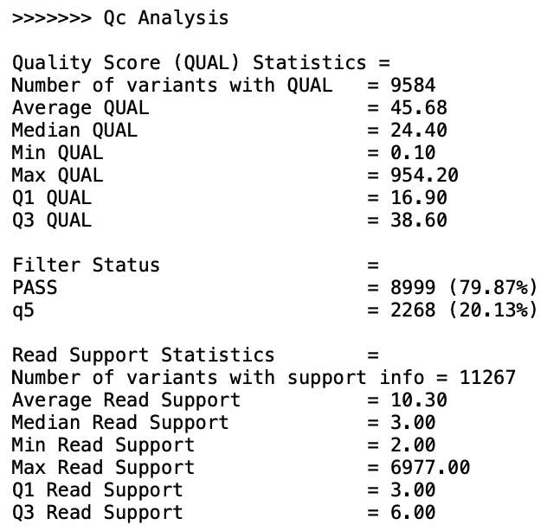
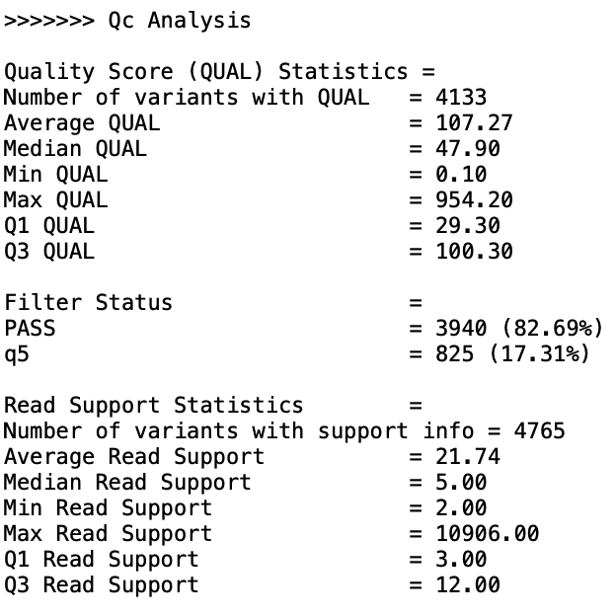
“Clean” has higher SV quality score and higher read support
PC3_10_cells_MDA_Mk1c_dirty
PC3_10_cells_MDA_P2_dirty
PC3_bulk_WGS_Mk1c_clean
PC3_bulk_WGS_P2_clean
PC3_bulk_WGS_Pacbio_clean
Notes:
Make sure the training set is good. Read, more. Yes or no, sequence + breakpoint, only think about the first step, training set, more and accurate.
Input: fastq file, yangyang can convert the fastq file. Breakpoint information.
Fastq read ID: fastq, ID: breakpoint
Positive data set.
Truth dateset. Also fastQ.
Two 60% positive, 40% negative control.
Supporting reads. High confidence. Nanopore.
FastQ format.
Artifacts. Evidence proving it’s true.
Only care about it’s yes or no.
Control noise, accurate very important!!!

Slide 5
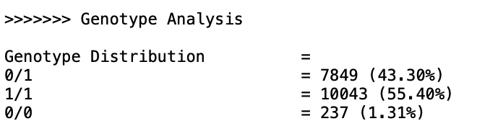
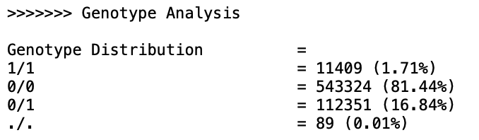
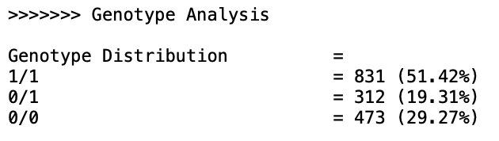
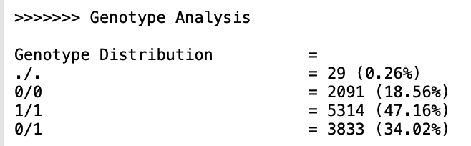
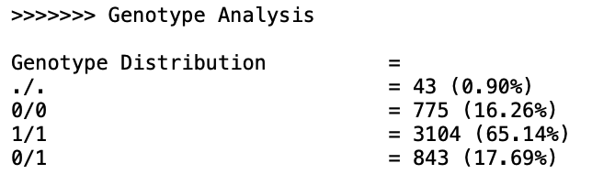
“Clean” and “dirty” has significant SV genotype difference
PC3_10_cells_MDA_Mk1c_dirty
PC3_10_cells_MDA_P2_dirty
PC3_bulk_WGS_Mk1c_clean
PC3_bulk_WGS_P2_clean
PC3_bulk_WGS_Pacbio_clean
Notes:
Make sure the training set is good. Read, more. Yes or no, sequence + breakpoint, only think about the first step, training set, more and accurate.
Input: fastq file, yangyang can convert the fastq file. Breakpoint information.
Fastq read ID: fastq, ID: breakpoint
Positive data set.
Truth dateset. Also fastQ.
Two 60% positive, 40% negative control.
Supporting reads. High confidence. Nanopore.
FastQ format.
Artifacts. Evidence proving it’s true.
Only care about it’s yes or no.
Control noise, accurate very important!!!

